Slide 1
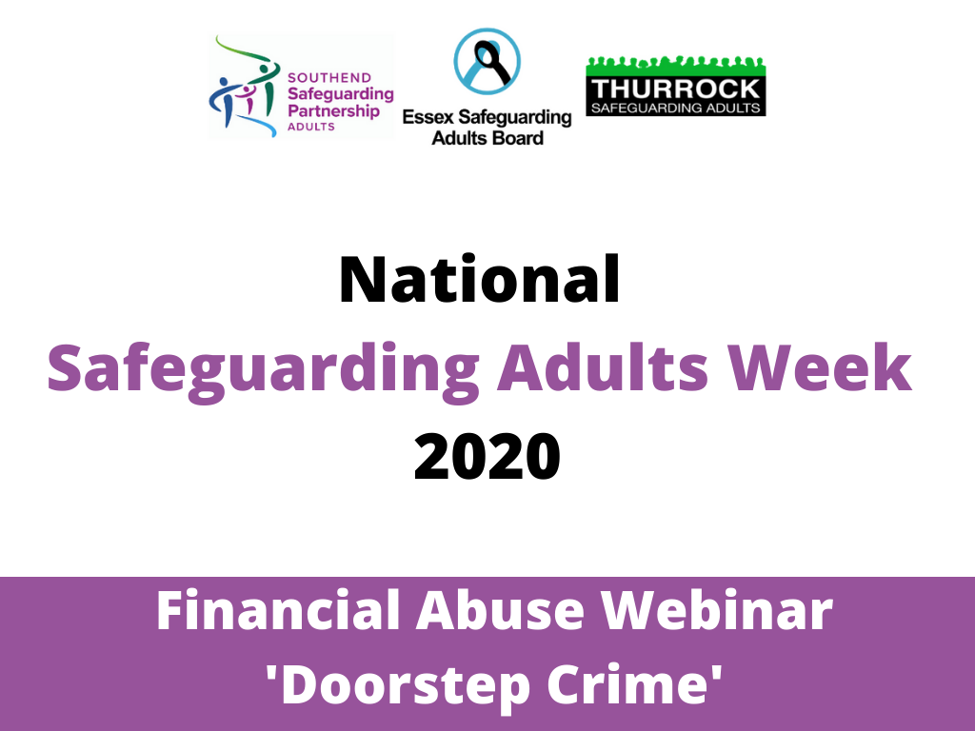
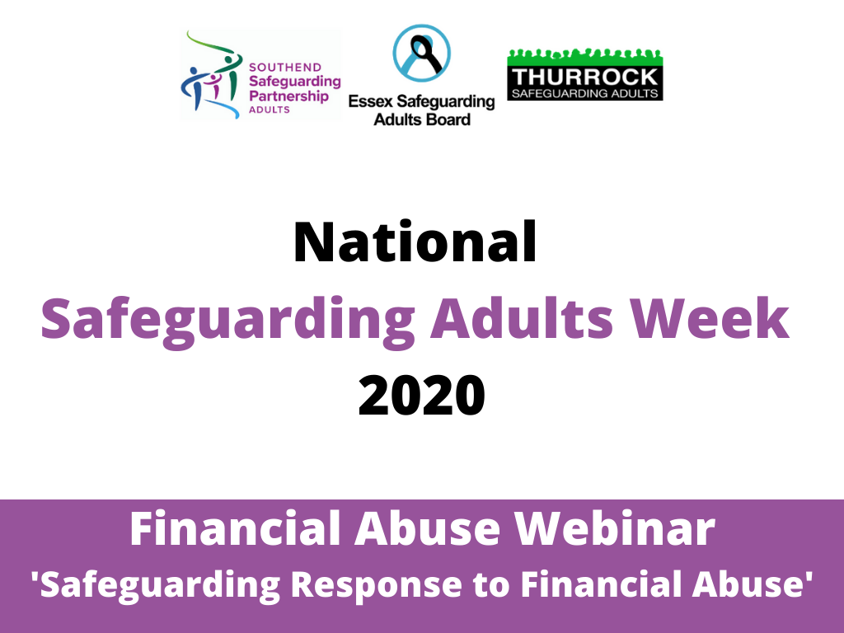

Slide 2
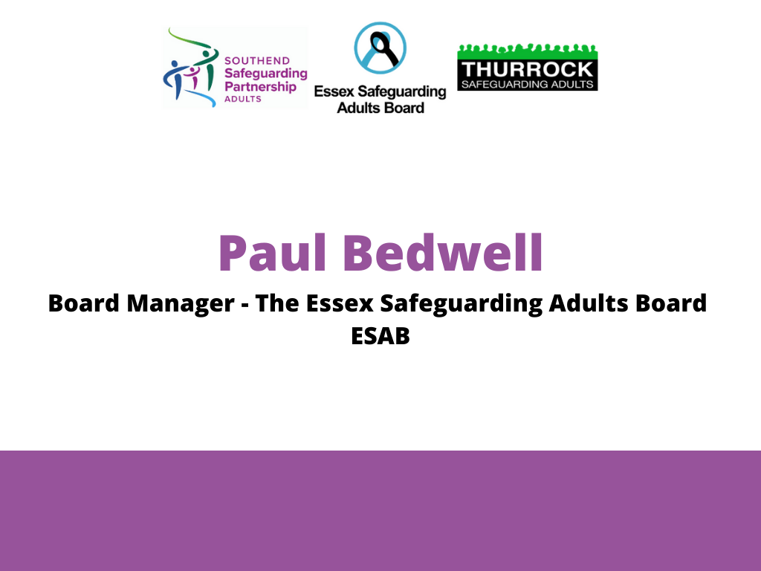

Slide 3


Slide 4
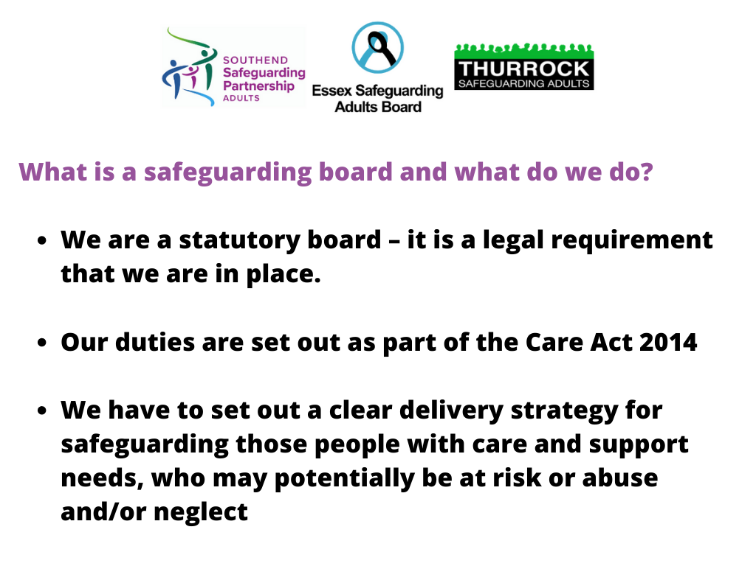

Slide 5


Slide 6


Slide 7
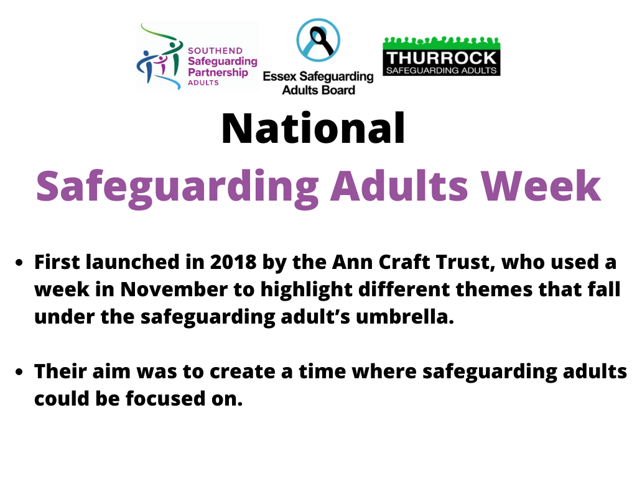

Slide 8
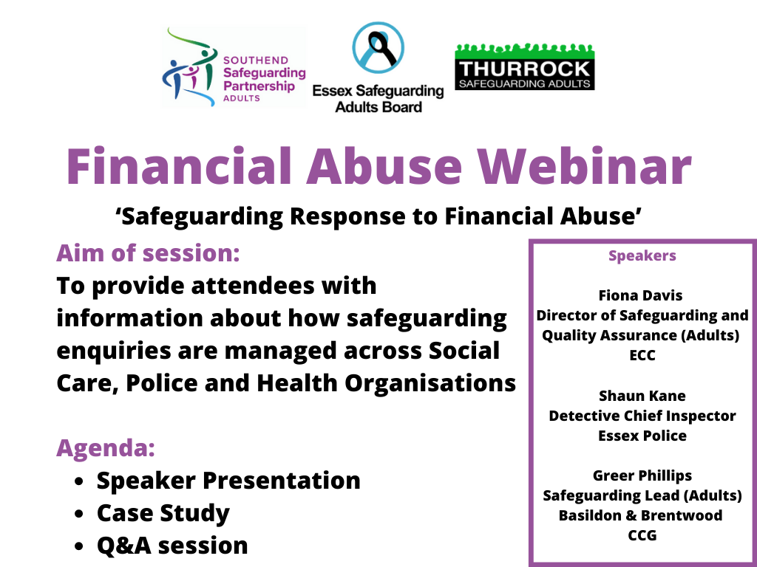

Slide 9


Slide 10
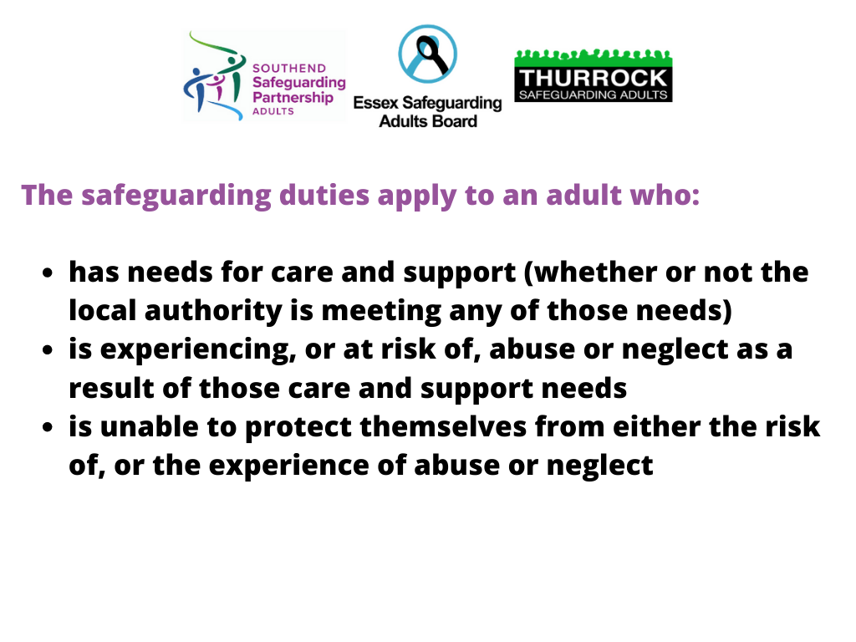

Slide 11
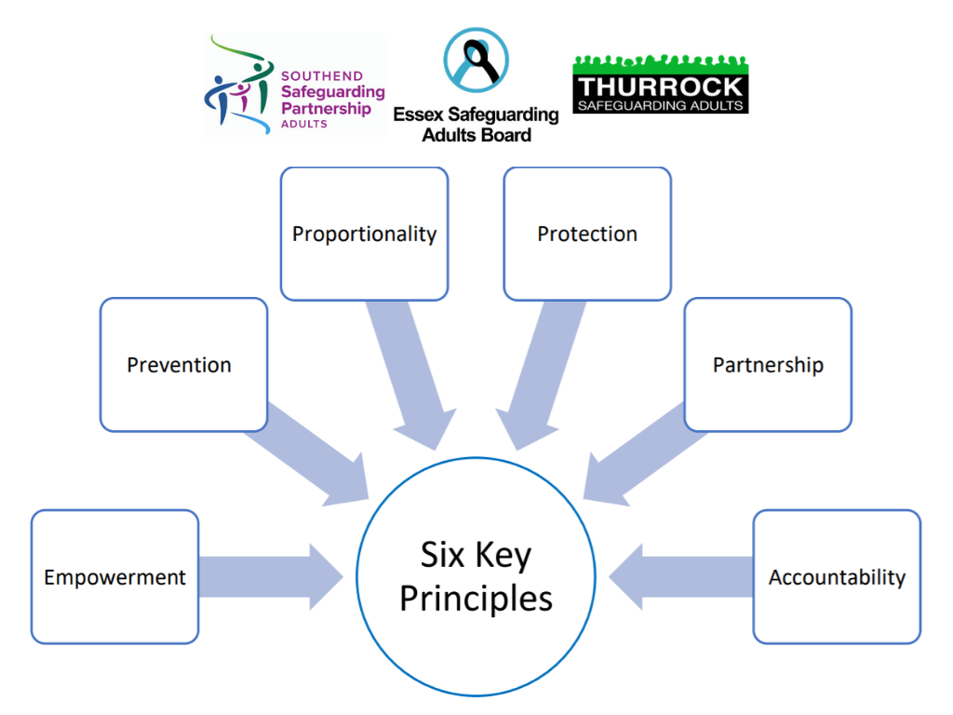

Slide 12
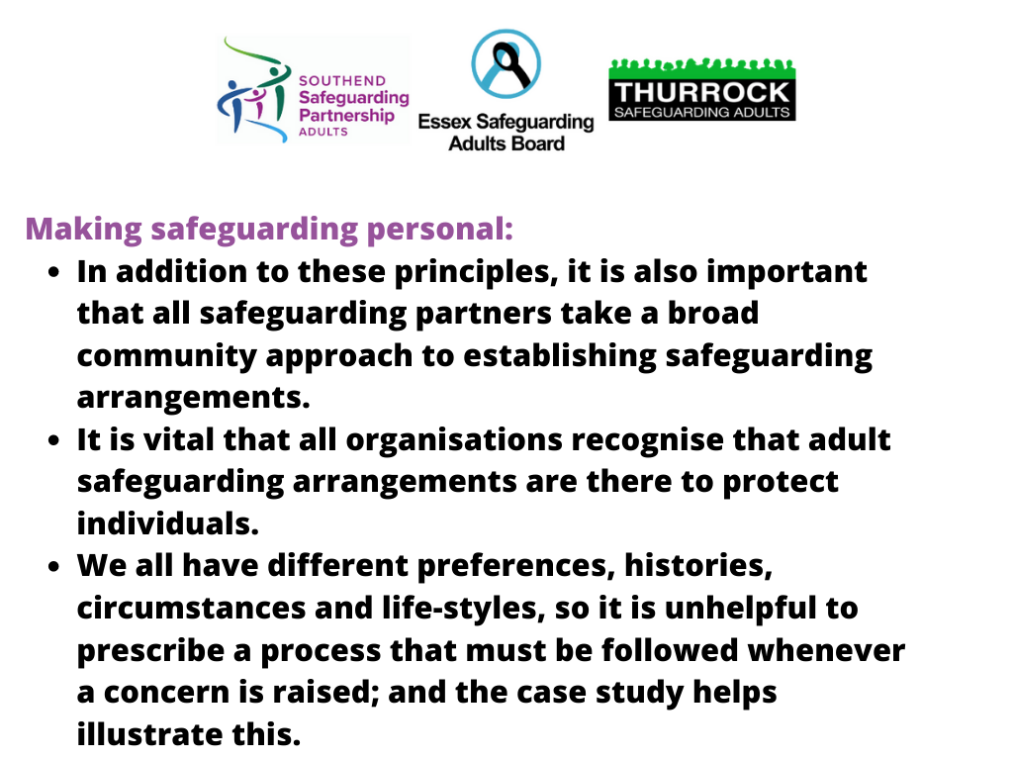

Slide 13


Slide 14
Introduction
Everyone is entitled to the protection of the law and access to justice. Some types of abuse and neglect often constitute criminal offences (for example physical or sexual assault or rape, psychological abuse or hate crime, anti-social behaviour, wilful neglect or unlawful imprisonment). Most common criminal offences are theft and fraud and in relation to financial abuse, research shows women are twice as likely as men to be victims of elder financial abuse.
The interface between safeguarding adults procedures and criminal investigations can require clarification of expectations regarding the roles and responsibilities of the local authority and police when working in partnership during enquiries concerning abuse or neglect.
Although the local authority has the lead role in undertaking safeguarding enquiries or requesting others to do so, where criminal activity is suspected, early involvement of the police is essential. Police investigations should be coordinated with the local authority who may support other actions, but should always be police led.
Notes:
Elder Financial Abuse – majority between the ages of 80 – 89 and living alone. Those who are single or widowed are also at risk. Incidence increases with age for men.

Slide 15
Common Safeguarding issues
Financial or material abuse, including theft, fraud, exploitation, pressure in connection with wills, property or inheritance or financial transactions, or the misuse or misappropriation of property, possessions or benefits.
Financial Infidelity Abuse
Financial abuse is a tactic used by one person in a relationship to gain power and control by limiting access to money, assets, and family finances. While they can be linked, they are two separate behaviours. Many relationships can survive financial infidelity; most cannot survive financial abuse.
Indicators of Financial Abuse
Restricting access to bank accounts, credit cards or cash. Making someone ask permission to spend their own money. Denying someone access. Refusing to contribute to shared costs or child support.
Responding to a Concern
Gather more information or evidence as to what is occurring, talking to the person. Alert the person’s financial institution (bank). Contact local Adult Protective Services and Police.
Notes:
Partnership working within safeguarding enquiries and criminal investigations:
If, as a result of a safeguarding concern, both a safeguarding enquiry and a criminal investigation are required the following will apply:
The Safeguarding will take primacy (Investigation will run alongside).
Depending on the nature of the safeguarding concern, a joint visit to the adult may need to take place with the police and the Lead Enquiry Officer.

Slide 16
Is it a Crime ? Suspected Criminal Offences
The primary focus must be to ensure the safety and well-being of the adult who is alleged to have been harmed. In an emergency situation calling police/ambulance immediately on 999. (Non Emergency 101/report Online)
Anyone can report a crime or suspected crime to police.
In situations where there has been, or may have been, a crime committed it is important that any evidence is preserved / secured wherever possible.
The police response will depend upon which criminal offences are suspected, whether the crime is still taking place, and on other factors such as whether anyone is at immediate risk of harm. The police may need to attend the scene and agencies and individuals can play an important part in ensuring that evidence is not contaminated or lost.
The Police will liaise with Trading Standards Service in relation to some crimes, particularly those relating to scams and doorstep crime.
The Police will also liaise with the Care Quality Commission (CQC) where crimes involve mental health hospitals and care homes/care providers occur.
Notes:
Police Response to Financial Abuse.
HOCR & NCRS assessment. If it’s reported as an offence from a third party professional, it will be crimed.

Slide 17
How should it be reported ? Safeguarding enquiries & criminal investigations
Where the local authority receives a safeguarding concern from a third party agency or individual, consideration should be given if the information indicates that a criminal offence has, or may have been committed. Where a criminal offence has, or may have, been committed and there is any doubt if it has previously been reported to police, a report should be made to the police.
Following the report to Police a completed SETSAF from professionals should be sent to oc.triage.team.adult@Essex.police.uk
Essex Police has a direct referral process for ALL police officers to raise a safeguarding concern with the local authority. The (SETSAF) should be completed by the police for every safeguarding concern that meets the criteria of Section 42 of the Care Act (and then send it to the Adult Triage Team for further dissemination to the local authority where appropriate). It is important that when the police are completing a SETSAF that they add sufficient and accurate detail to allow specialist teams and the local authority to act on it. The expectation is that the submitting officer will also state on the form why they are making the referral and whether the adult at risk is aware of it.
Notes:
A multi- agency planning meeting may need to be convened to agree:
The safeguarding plan for the adult and any other vulnerable adults including the suspect.
The lead individual for each action within the safeguarding plan.
Ownership of any actions ancillary to the investigation (e.g. Disclosure and Barring Service referrals).
The process and time scales for ongoing updates and reviews.
Ending safeguarding enquiries when a criminal investigation is ongoing
When there is a safeguarding enquiry involving a criminal investigation, the police will lead the criminal investigation and contribute towards the safeguarding enquiry.
The criminal investigation may be closed whilst a safeguarding enquiry is still ongoing. The police may notify the local authority on the outcome of the criminal investigation and at which point any further follow up or further safeguarding enquiry required will be led by the local authority.

Slide 18
How will it be investigated ?
Where police are informed and a criminal investigation is started, the adult’s views will be considered by the police investigating officers even when the adult had not consented to the report being made. Safeguarding will always take primacy and the investigation will run alongside. Dependant on the nature of the crime, an appropriate investigative strategy is applied and officer allocated.
If an adult is disclosing potential criminal offences, any initial questioning should be intended only to elicit a brief account of what is alleged to have taken place. This brief account should include where and when the alleged incident took place and who was involved, and should be recorded in writing at the time or as soon as possible afterwards. A more detailed account will be obtained by the police at later stage. Dependant on the vulnerability various methods to achieve best evidence will be applied. (ABE, App Adult, Special Measures, Intermediaries)
All investigations are undertaken proportionately, based on the evidence and subsequent CPS evidential test.
Notes:
Information about a suspected crime should be shared with the police, examples such as:
If others are, or may be, at risk of abuse or neglect.
Where there are legal or professional responsibilities of staff and concerns of neglect or abuse have been raised.
If the adult is believed to be subject to undue influence such that they are unable to exercise free will, for example Modern Slavery, controlling and coercive behaviour or domestic violence and abuse.
Evidential Test – Admissibility, credibility and reliability of the material. If these are met, we will then consider the Public interest Test.

Slide 19


Slide 20
What are Clinical Commissioning Groups (CCGs)?
Created following the Health and Social Care Act in 2013 and replaced Primary Care Trusts on 1st April 2013 Clinically-led statutory NHS bodies Led by an elected local Governing Body made up of General Practitioners (GPs), other clinicians including nurses and consultants, and lay members As of 1 April 2020, following a series of mergers, there are 135 CCGs in England Accountable for approximately 2/3 of the total NHS England budget (£79.9 billion in 2019/20) (https://www.nhscc.org/ccgs/2019 )

Slide 21
Responsibilities
CCGs are independent, and accountable to the Secretary of State for Health and Social Care through NHS England
assessing local health needs
Deciding health related priorities and strategies
buying health services on behalf of the population (from providers such as hospitals, clinics, community health bodies, etc.)
responsible for the health of their entire population, promoting equality and reducing health inequalities

Slide 22
Safeguarding Support
Financial abuse Responsibilities
Provide guidance on identifying adults at risk from different sources and in different situations
Provide advice to commissioned services on how to improve systems for safeguarding adults
Understand and embed the routes of referral for adults at risk across the health system
Provide a health advisory role to the Providers and Social Care
Effective inter-agency working with local authorities, the police and third sector organisations which includes appropriate arrangements to cooperate with local authorities
Facilitate appropriate sharing of information.
Notes:
be available.

Slide 23


Slide 24


Slide 25
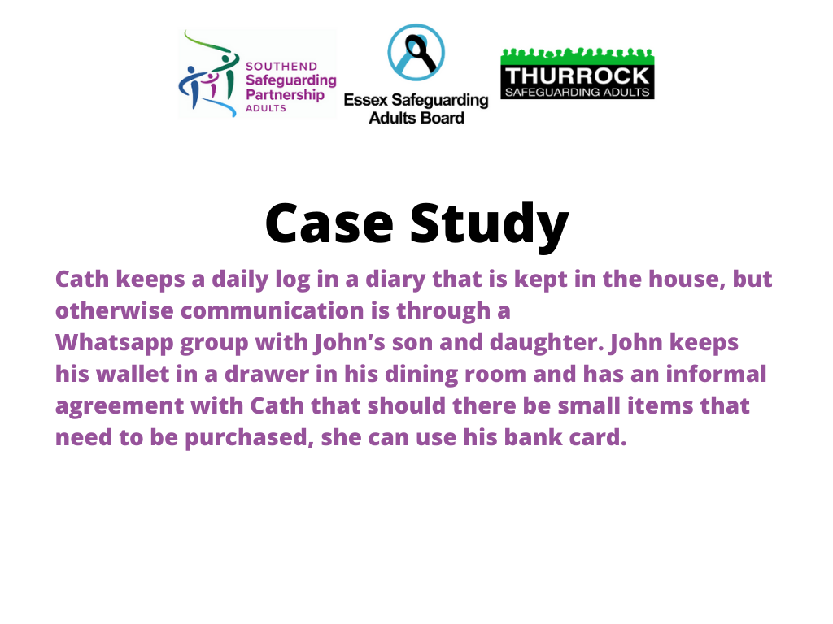

Slide 26


Slide 27
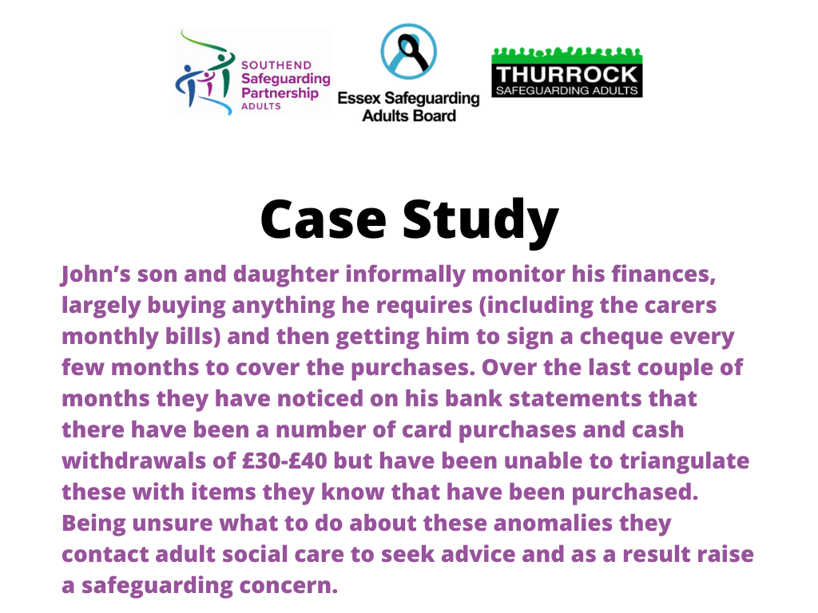

Slide 28


Slide 29


Slide 30


Slide 31


Slide 32


